Slide 1
Microprocessor prototyping by non-technical inventors
Alamo Inventors meeting
Jan. 10, 2018
James C. Brakefield

Slide 2
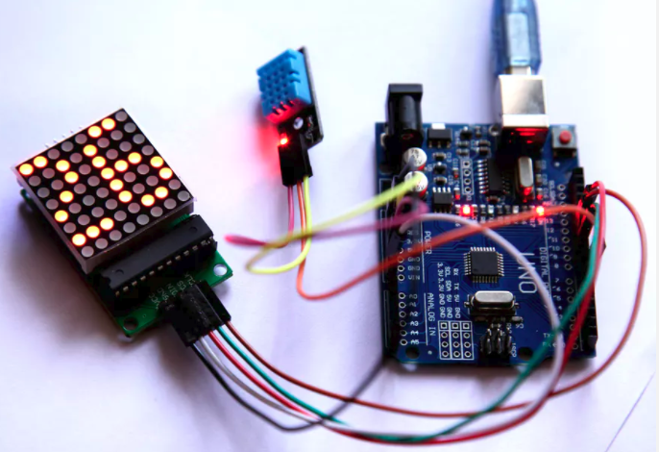
The Rough Prototype https://www.hackster.io/nekhil-ravi/current-temperature-on-8-8-led-dot-matrix-321b0a

Slide 3
Some Nostalgia
8080 1974 Intel 8-bit data, 16-bit address followed by 8085 and 8051
6502 1975 MOS Tech 8-bit data, 16-bit address Apple, Commodore, Atari
Z80 1976 Zilog 8-bit data, 16-bit address Osborne 1, KayPro, TRS-80
8086 1978 Intel 8 & 16-bit data, 20-bit address PC

Slide 4
Current microprocessors
PIC 1975 Microchip 8-bit data, 8-bit address 10B+ mfg’d, separate data & instruction mem
AVR 1996 Atmel 8-bit data, 16-bit address 1B+ mfg’d, basis for Arduino boards
MSP430 1993 TI 8/16-bit data, 16-bit address 1B+ mfg’d, low power, LaunchPad boards
ARM 1985 ARM Holdings 8/16/32-bit data, 32-bit adr 100B+ mfg’d, also 64-bit data & address, ARM
licenses to mfgs, basis for Raspberry Pi boards
STM8 STMicro 8-bit data, 24-bit adr, 2B+ mfg’d

Slide 5
Other notable uP choices
ESP8266, ESP32: Espressif 32-bit RISC
WiFi & BlueTooth radio built in, low cost
PSoC: Cypress ARM chip
Touch pins, A2D, various IO, Progammable logic
ZPUino: Oyvind Harboe & Alvaro Lopes
32-bit soft-core (FPGA) processor, runs Linux
Beagleboard.org: TI ARM chip
Four rows of IO, various form factors
ARM(s) + FPGA: Xilinx, Altera(Intel), Actel(Microsemi)
Bespoke FPGA soft core uP: For the very brave

Slide 6
Pinouts & Form factors
Boards provide processor signal breakout areas
Bused to other boards and are allocated by user
Raspberry Pi: Two rows of 20 pins with 0.1” by 0.1” spacing along one PCB edge, 3.3 volt IO
Arduino: Two rows of 0.1” spaced pins 2” apart (board is 2.1” wide), 5 volt IO
DIL breadboard: PCB is about 1” wide with 0.1” spaced pins on each side, IO caution: 5 or 3.3 volts
Miscellaneous: Dual DIL, circular (for clothing), snap or click together…

Slide 7
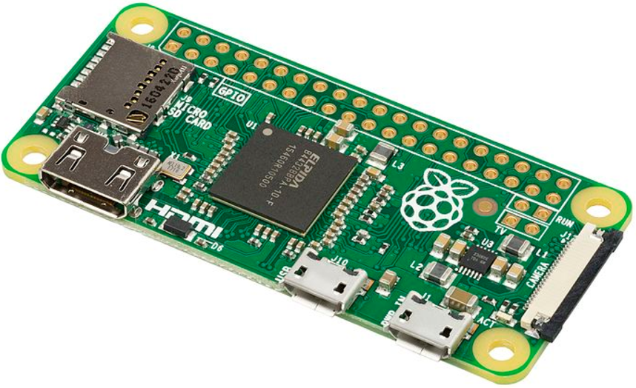
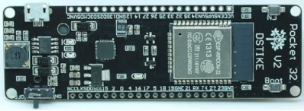
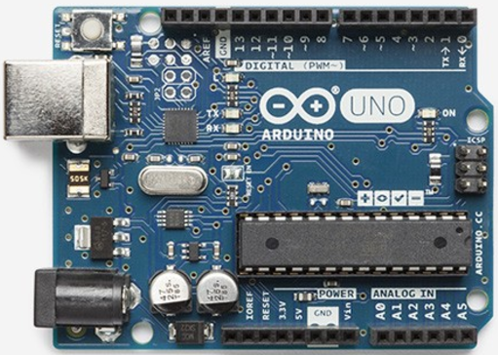
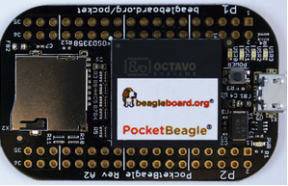
Microprocessor boards

Slide 8
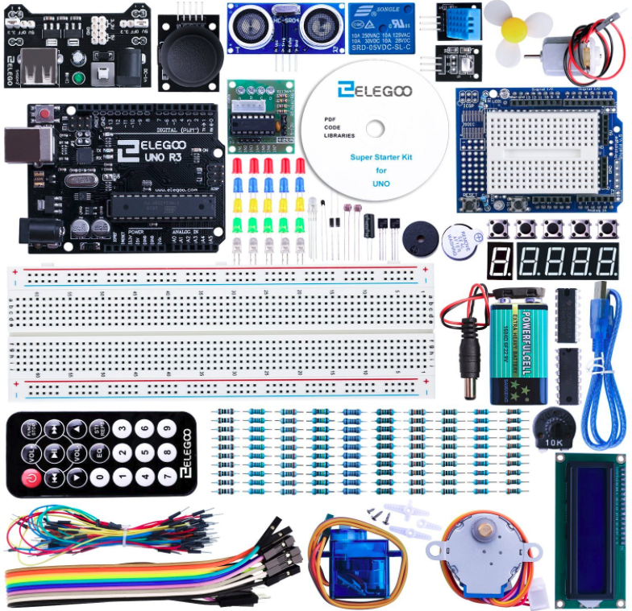
Arduino Kit

Slide 9
Accessory boards
Hats & shields Stackable boards plugging into Arduino or Raspberry Pi, also Wemos & Tinycircuits
Pmod 6 & 12 pin; supports I2C, SPI, analog & digital
Grove 4 pin; supports I2C, analog & digital; cables pre-assembled
Breakout boards Provides 0.1” spaced holes connected to chip pins (often miniscule)

Slide 10
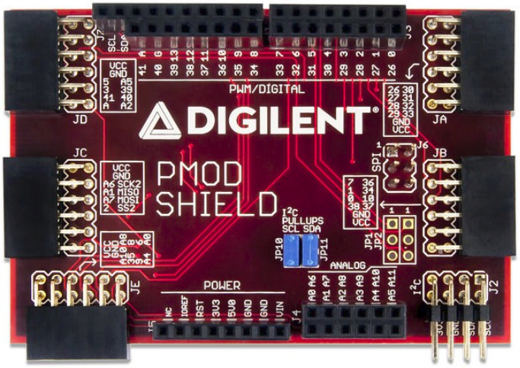
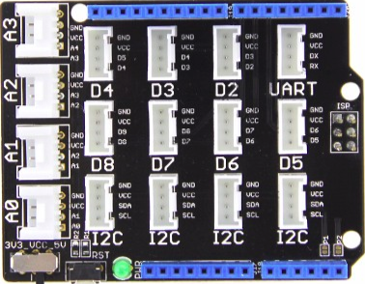
Pmod & Grove Hats for Arduino

Slide 11
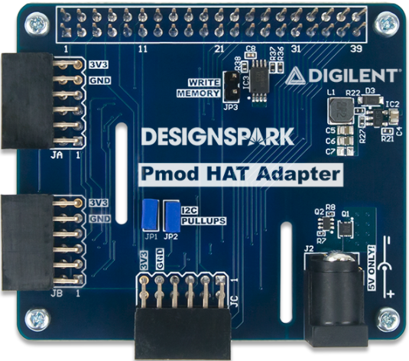
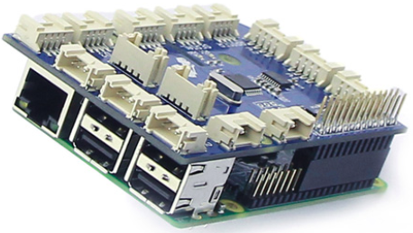
Grove & Pmod Hats for Raspberry Pi

Slide 12
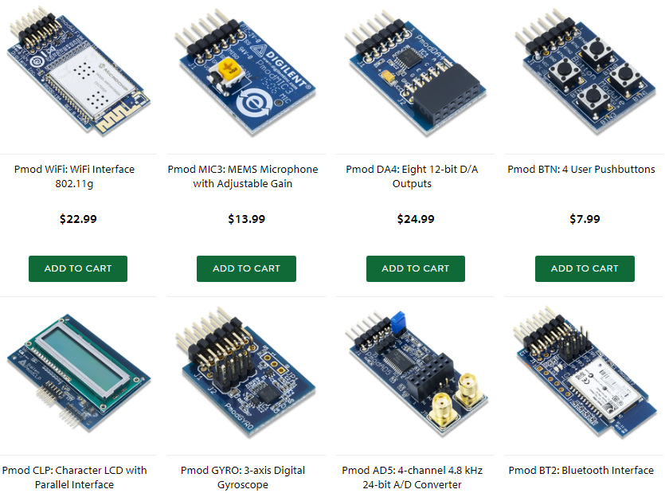
Pmod (www.digilentinc.com)

Slide 13
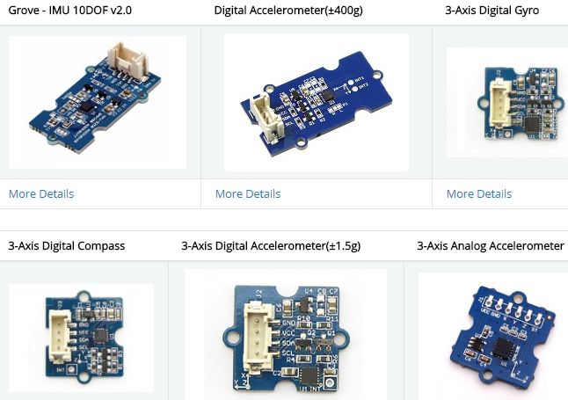
Grove (seeeddoc.github.io/Grove_System/)

Slide 14
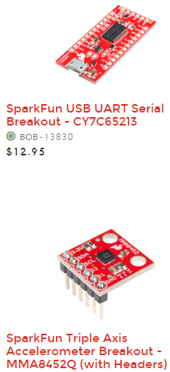
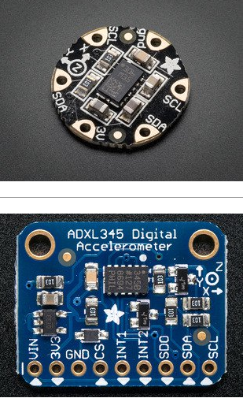
Breakout boards (adafruit & sparkfun)

Slide 15
Vendors (partial list)
Amazon: boards, kits, hobby electronics, books
Adafruit: boards, kits, hobby electronics
Sparkfun: boards, kits, hobby electronics
Pololu: boards, kits, hobby electronics, motors
Element14: parts, boards, kits
Digikey: parts, boards
Mouser: parts, boards
Banggood, AliExpress and Alibaba (all Chinese)

Slide 16
Raspberry Pi Zero W demo
From UK for education, open source, rock bottom pricing, 10+ million sold (of all versions)
Linux software on SD card, several hundred MB of DRAM, USB ports, HDMI port
Clones almost always use ARM processor
Standard software install includes Mathematica, Python, MineCraft, Office tools…

Slide 17
Arduino Uno demo
From Italy: Interaction Design Institute of Ivrea
Open source, 23+ variations, hundreds of clones
Arduino IDE runs on PC or other host, plugins for non-AVR processors, configuration files for each and every supported board, programs called “sketches”, over 1000 libraries available
Supported processors: AVR, ARM, PIC18 , microBlaze, MIPS, MSP430, Leon3 Sparc, PIC32, RISC-V, x86, Xtensa ESP32 & ESP8266, ZPUino

Slide 18
Ways Forward
Hire a college student
Get your children/grandchildren involved
Learn/experiment/break the ice
Take some courses, read books, watch videos
Attend vendor presentations
Trade shows (exhibits usually free)
Manufacturer seminars (almost free)

Slide 19
Neat videos
RaspberryPi for beginners: www.youtube.com/watch?v=eObSqbe9aqU
Learn Arduino in 15 minutes: www.youtube.com/watch?v=nL34zDTPkcs
At 12:55 "touch pin" music: www.youtube.com/watch?v=SBG7ccW5gpA
At 1:50 & 8:29 Build Your Own Arduino Uno: www.youtube.com/watch?v=sNIMCdVOHOM
Andreas Spiess videos on YouTube: www.youtube.com/channel/UCu7_D0o48KbfhpEohoP7YSQ

Slide 20
Web Links
Wikipedia web pages “en.wikipedia.org/wiki/…”
Arduino, ARM_architecture, Atmel_AVR, BeagleBoard, Intel_8080, Intel_8086, LEON, MicroBlaze, MIPS_architecture, MOS_Technology_6502, NXP_ColdFire, PIC_microcontroller, Pmod_Interface, PSoC, Raspberry_Pi, RISC-V, Tensilica (Xtensa) ESP32, TI_MSP430, Zilog_Z80, ZPU

Slide 21
Web Links cont’d
Arduino or Raspberry board finder: www.board-db.org
Arduino software libraries: www.arduinolibraries.info, www.arduino.cc/en/Reference/Libraries
Arduino web links: www.arduino.cc/en/Main/Products, www.arduino.cc/en/Main/Software, www.wikipedia.org/wiki/List_of_Arduino_boards_and_compatible_systems
Raspberry Pi web links: www.raspberrypi.org, www.elinux.org/RPi_Hub, www.raspberrypi.org/magpi
microPython: https://micropython.org/

Slide 22
Web Links cont’d
Pmod: store.digilentinc.com/pmod-modules, maximintegrated.com (search for Pmod), wiki.analog.com/resources/alliances/xilinx#pmods
Grove: wiki.seeed.cc/Grove_System, www.dexterindustries.com/GrovePi/supported-sensors
Qwiic: sparkfun.com/qwiic
Snap Circuits: http://www.snapcircuits.net/
littleBits: https://littlebits.cc/
freeRTOS: https://www.freertos.org/

Slide 23
Raspberry Pi boards
All have: HDMI video out, USB ports(s), SD card for “disk” storage, camera connector, WiFi, 40 pin GPIO DIL header
Pi Zero W: ARM11 processor, 512MB memory, 1.18” by 2.56”
Pi 1: ARM11, 512MB memory, 2.22” by 2.56”
Pi2: ARM quad Cortex A7, 2.22” by 3.37”
Pi3: ARM quad Cortex A53 (64-bit processor), 1GB memory, 2.22” by 3.37”

Slide 24
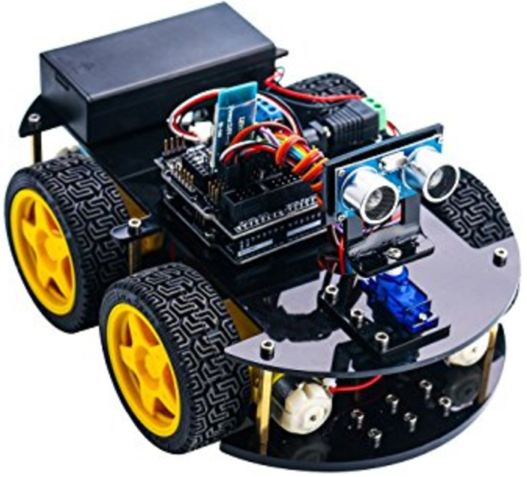
Elegoo Smart Car Robot kit

Slide 25
ESP8266 & ESP32: ESP32-DEVKIT
Espressif created the ESP8266 chip using the Xtensa ASIC processor core. It’s a 32-bit RISC processor with 16 and 24-bit instructions (very good code density). The ESP8266 also includes a WiFi radio. The chip has RAM and uses a separate flash chip for program storage. Very basic ESP8266 modules cost about $3. Available in chip, module and board form factors (picture on next slide).

Slide 26
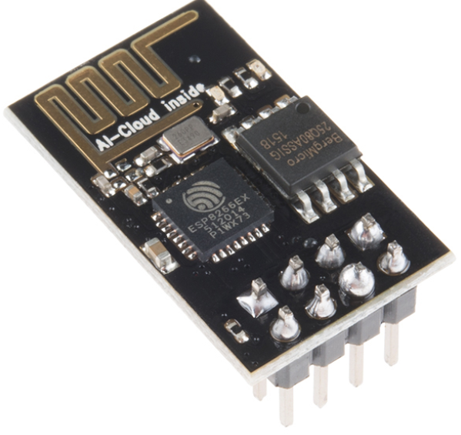
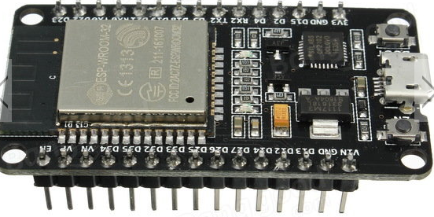
ESP8266 & ESP32: cont’d
The ESP32 chip includes two Xtensa processors along with the Wifi/Bluetooth radio and 512KB of RAM. Clock rate up to 240MHz. Available in chip, module and board form factors.

Slide 27
FPGA offerings: Papilio, XESS, Alorium, ZPUino, F32C (MIPS/RISC-V) & Pipistrello (uBlaze)
Papilio provides the DesignLab IDE tool, based on the Arduino IDE, that connects to the Xilinx ISE schematic editor tool.
Library components can be attached to a soft-core 8-bit AVR or 32-bit ZPUino. Arduino sketches provide the programming for the soft-core AVR or ZPU.
No VHDL or Verilog required. The XESS setup is similar but not as seamless.

Slide 28
Some Other Time
LoRa: Long range radio using sub GHz bands, up to 100km range, low bandwidth
microPython: Runs on medium size uP
Node Red: Schematic editor for operation of networked nodes
FPGA soft-cores: AVR, microBlaze, MIPS, RISC-V & ZPU cores, ZPU runs Linux, user adds peripherals schematically
IOT: WiFi becoming standard on base boards

